Slide 1
Core Lab Interaction | Class 2 Version Control, CSS and Floats

Slide 2
The Reading
What did you learn?

Slide 3
The Reading | Key Concepts
Lists – ways to create lists of items
Images
Links
Quotations

Slide 4
Version Control

Slide 5
What is Version Control?
Version control is a way to save versions of files. Its main features are:
Keeping a record of who changed what
Tracking changes on a file
Saving your butt when you try something new and end up breaking everything

Slide 6
Why Version Control?
Individuals
Backups
Change History
Branches to safely try new stuff
Teams
Allows multiple developers to edit a file
Merges changes from devs
Answers who did what, when and why

Slide 7
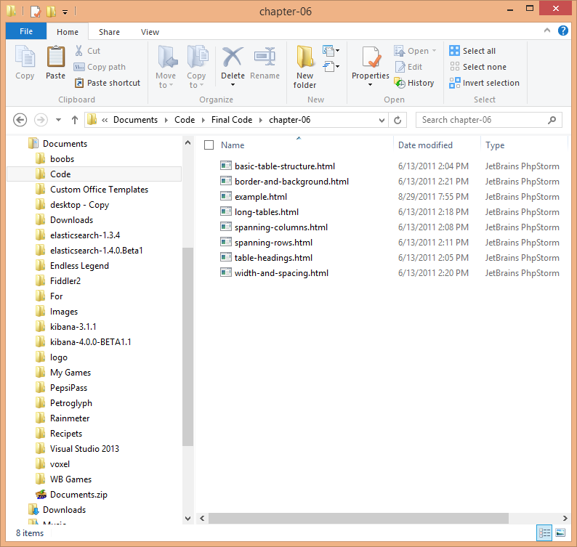
History | First the text file
Files were tracked by renaming, was inefficient slow and prone to human error.

Slide 8
History | Centralized Version Control
The first version control systems were centralized – meaning that they were controlled at one place, and people would check in and out files.
Main Centralized VCS
CSV
SVN
VSS

Slide 9
History | Distributed Version Control
Centralized Version Control system were prone to errors, and required internet access – thus the distributed VCS was created where file history was stored locally on everyone's computer.
Main Centralized VCS
GIT
Mercurial

Slide 10
GIT
GIT is one of the leading version control systems developed by linus travoldis.

Slide 11
GIT
Download Git: http://git-scm.com/download/mac
Signup for github: https://github.com/

Slide 12
Using Git

Slide 13
Intro To CSS

Slide 14
Assignment
Reading:
HTML & CSS | Chapters 10 - 12
Development:
Create a simple page

